Slide 1

v
Tornadoes
in the USA
Predicting the severity of the
next Tornado in the United States
Oren Keinan // Daniel Shechtman

Slide 2

Tornadoes in the USA \\ Project Introduction
What will be the severity of the next
Tornado in the United States?
Data
Acquisition
Data
Cleaning
Machine
Learning
Visualisations

Slide 3
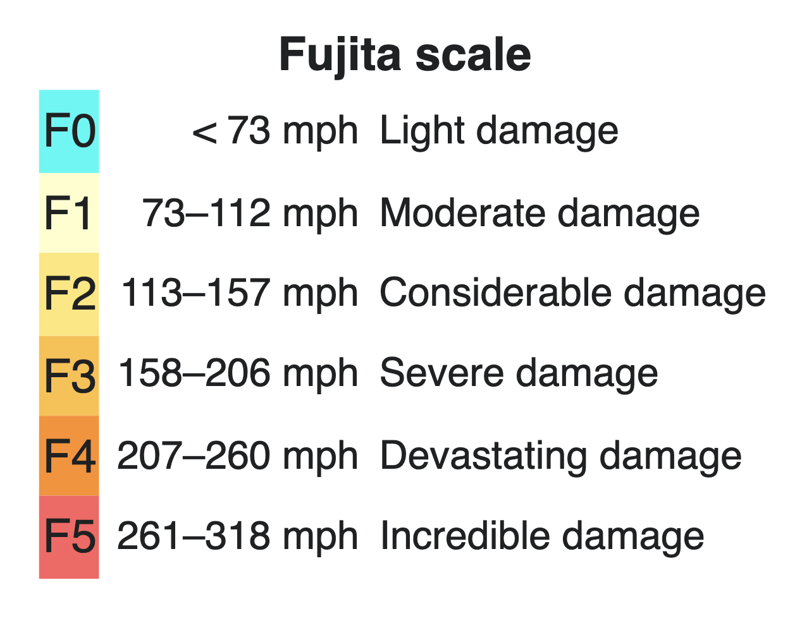
Tornadoes in the USA \\ Project Introduction
F Scale
The Fujita scale is a scale for rating tornado intensity, based primarily on the damage tornadoes inflict on human-built structures and vegetation.
The official Fujita scale category is determined by meteorologists and engineers after a ground or aerial damage survey, or both; and depending
on the circumstances, ground-swirl patterns (cycloidal marks), weather radar data, witness testimonies, media reports and damage imagery.

Slide 4


Tornadoes in the USA \\ Project Introduction
External Sources
Tornadoes by state since 1950 | elpasotimes.com
Wikipedia

Slide 5
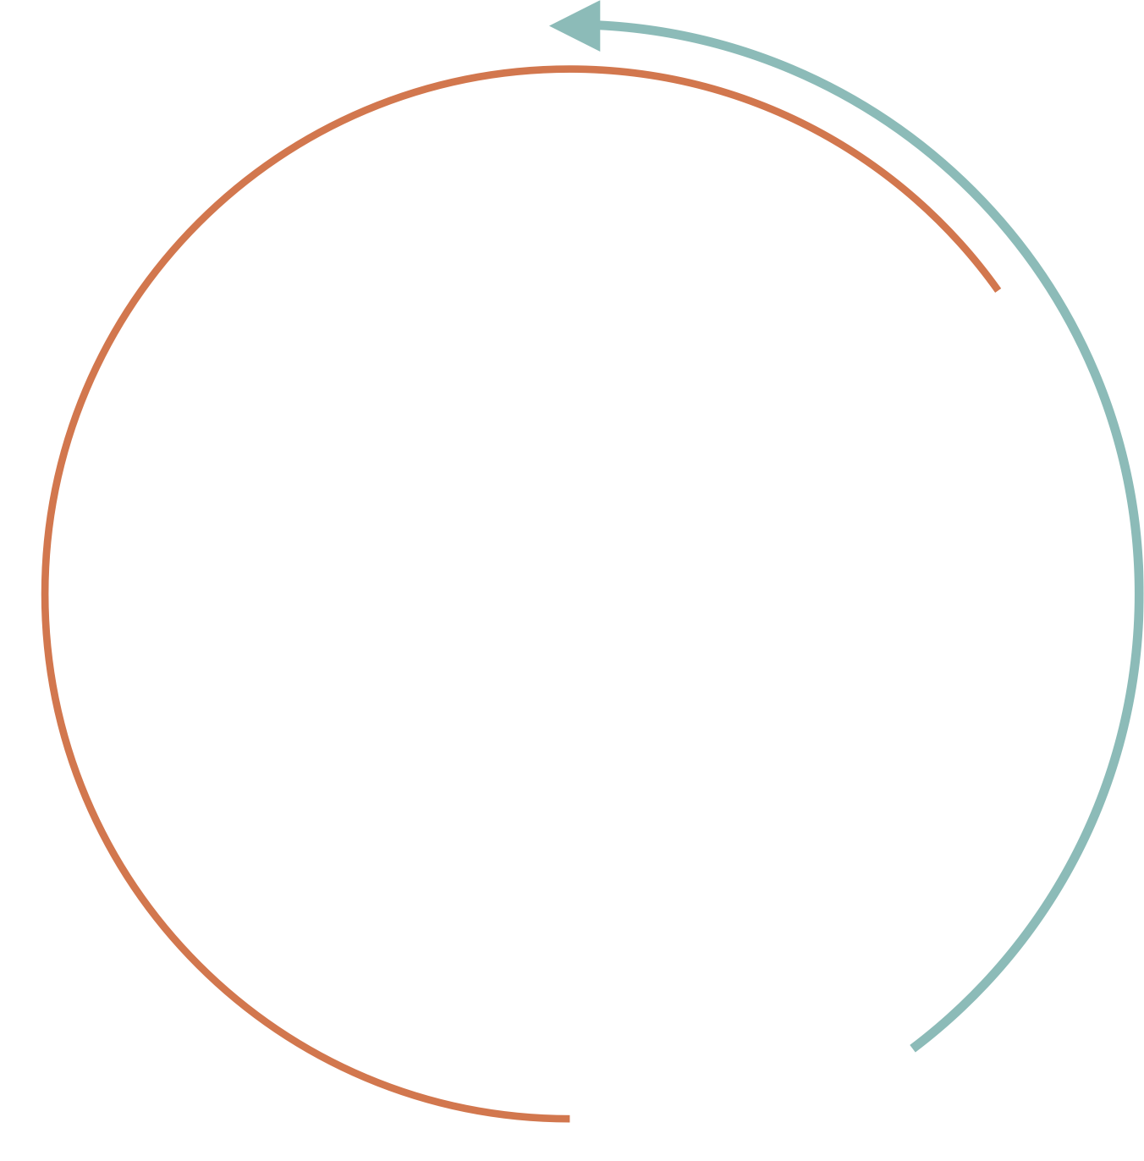

Data
Acquisition

Slide 6

Tornadoes in the USA \\ Data Acquisition
Crawling Using Selenium

Slide 7
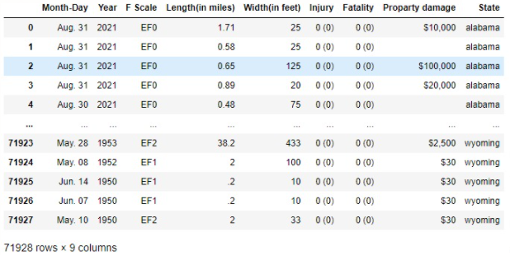
Tornadoes in the USA \\ Data Acquisition
Crawling
We gathered the information using Selenium
We understood that we want a big dataframe and that each row will represents a Tornado storm. that way, it would be easy for the machine to learn about each storm’s behavior and to predict it’s severity.
we added all the states together and created another column called "State"

Slide 8
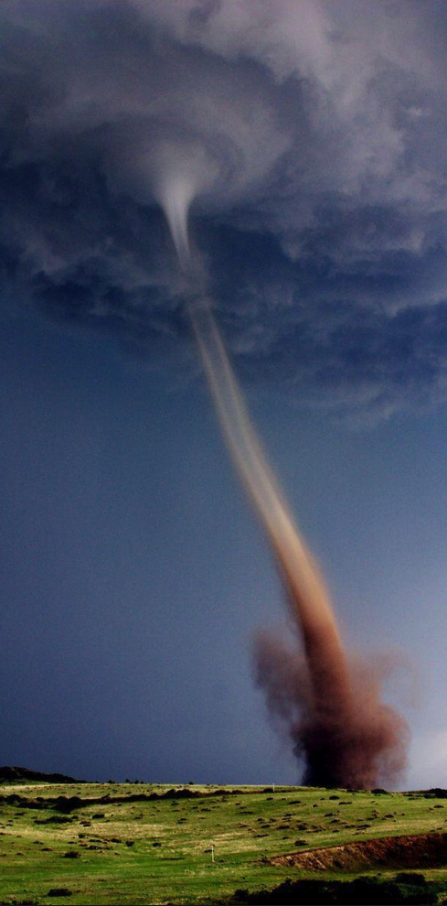
Tornadoes in the USA \\ Data Acquisition
Our Data Frame
Year – the year the Tornado accrued
Day Month – the day and month the Tornado accrued
Length (In miles) - how far did the Tornado travel
Width (in feet) - how wide was the circumference of the Tornado
Injury – how many people got injured from the Tornado
Fatality – how many people died from the tornado
Property damage – how much damage in dollars did the Tornado create
F Scale – what was the severity of the Tornado

Slide 9
Data
Cleaning

Slide 10
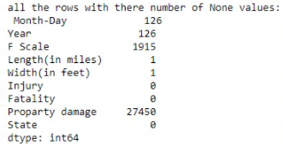
Tornadoes in the USA \\ Data Cleaning
Handling Missing Data
After creating the data frame we noticed information missing in some numeric columns, we decided to delete these rows completely
Also duplicated rows were deleted
We decided with Moshe Friedman to unify the F Scale attribute from 6 to 3 categories

Slide 11
Tornadoes in the USA \\ Data Cleaning
Before & After
After removing all the rows with missing information we beautified the data in the data frame
EF was removed from F Scale column
Injury and fatality columns - brackets were removed
property damage - coma removed ($) also removed and converted to int

Slide 12
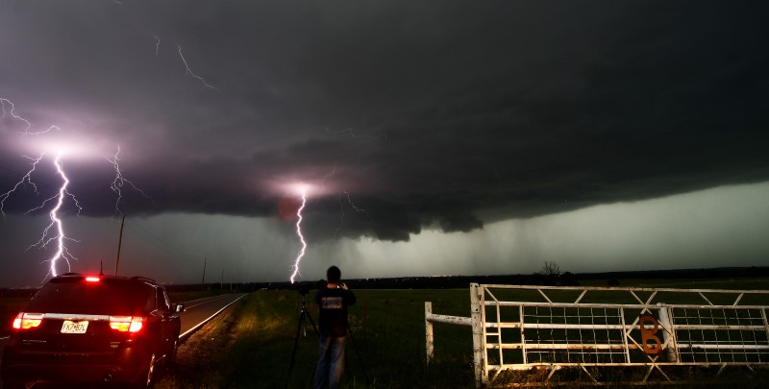
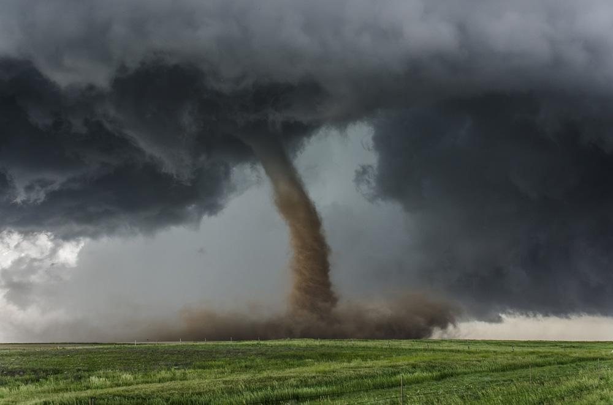
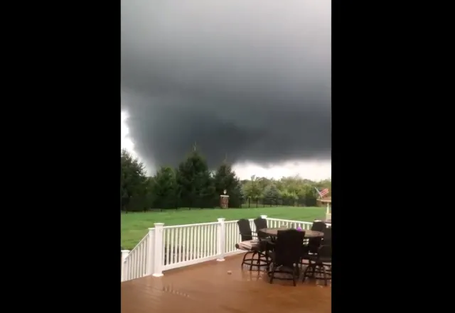
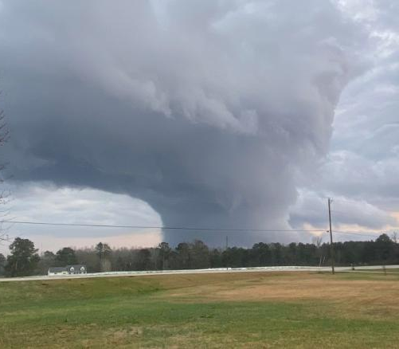
New Orleans, Louisiana \\ 2013
Visualisations
New Jersey, New York \\ 2021
Madison, Georgia \\ 2022
North Texas \\ 2016

Slide 13
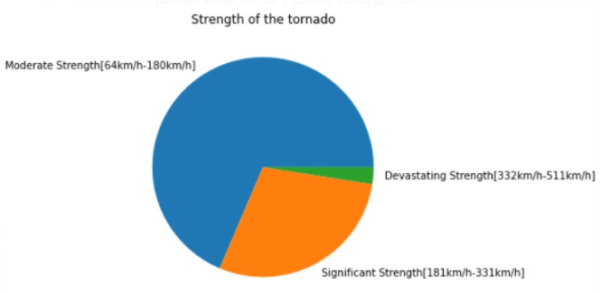
Tornadoes in the USA \\ Visualisations
Division By Severity
In the following pie chart,
we take a look at the division between the three categories
we decided to explore during
this project regarding the
severity of a Tornado storm.

Slide 14
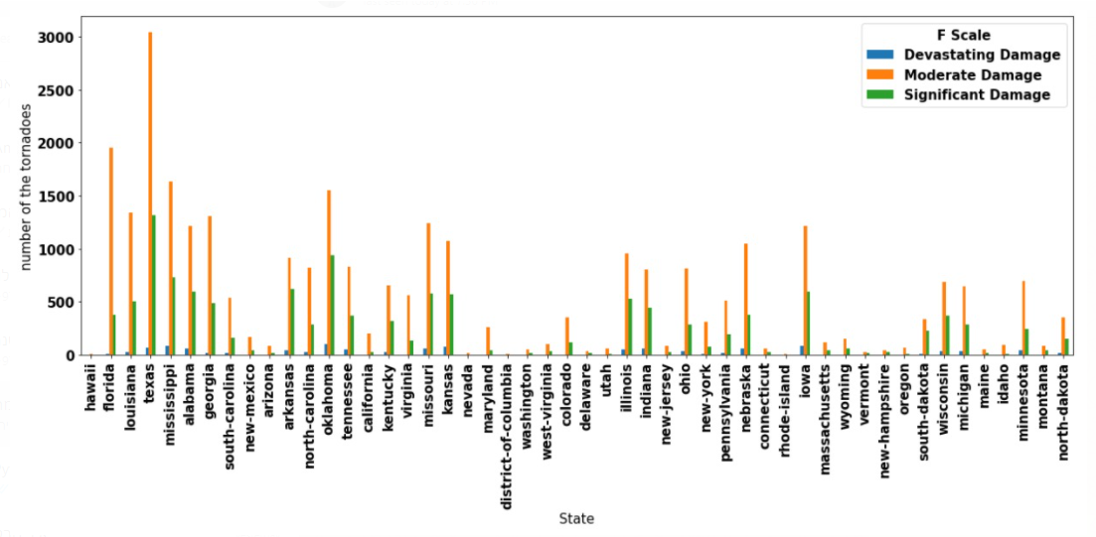
Tornadoes in the USA \\ Visualisations
South to North
In the following graph we see the states on the X axis sorted from southern to northern states. The Y axis represents number of tornadoes.
As we can see in general that the south states in the US will be subjected to more tornadoes than their northern states.

Slide 15
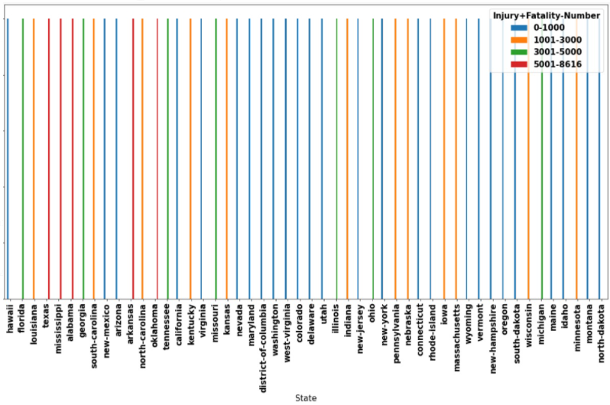
Tornadoes in the USA \\ Visualisations \\ South to North II
in this graph we sorted the states from south to north and added the fatalities and injuries to one number.
as we can see, the southern states have more fatalities
and injuries then the
northern states.

Slide 16
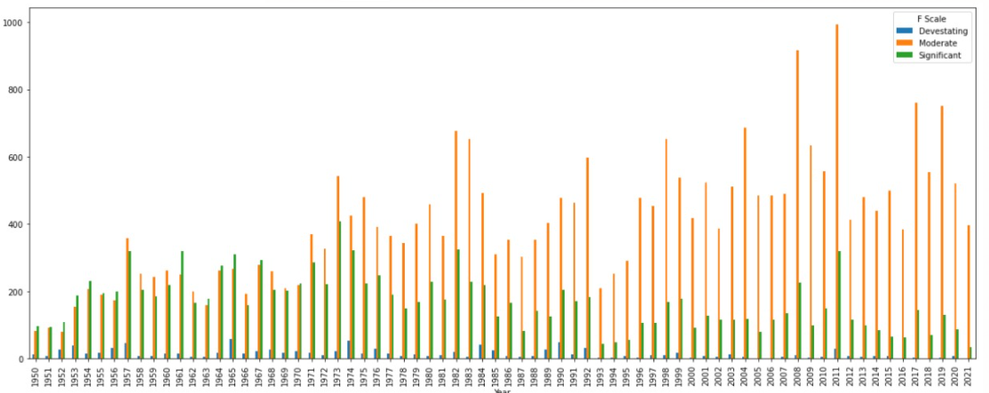
Tornadoes in the USA \\ Visualisations
Number of Tornadoes per year
In the following graph we see the years
on the X axis sorted from 1950 - 2021.
The Y axis represents number of tornadoes.
As we can see in general – in earlier years the US had lower numbers of tornado storms than more recent years.

Slide 17
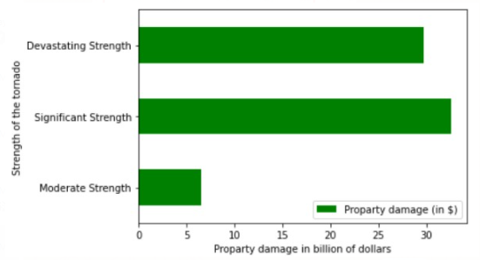
Tornadoes in the USA \\ Visualisations
Property Damage divided by Severity
Here is a graph that tells
us that property damage,
because of Significant
strength Tornadoes, is
bigger than Devastating strength Tornadoes.
Can you guess maybe why
is that? (the answer lies within the visualizations)
If you said that it's because that Devastating strength Tornadoes are very rare
you are correct!

Slide 18


Machine
Learning

Slide 19
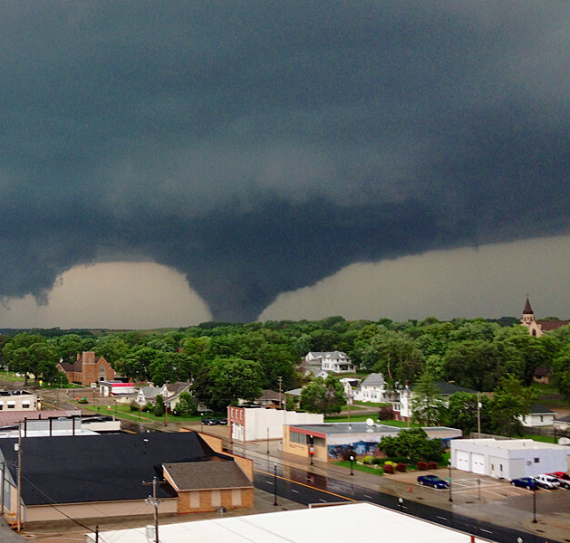
Tornadoes in the USA \\ Machine Learning
Logistic Regression
Our label is “F Scale” column, because our research question refer to if a Tornado is moderate significant or devastating . We chose to apply Logistic Regression – Supervised Learning for classification problems – categorical label.
Before the feature engineering stage, we got accuracy of 75%~. Our final model accuracy is 78~%

Slide 20
Tornadoes in the USA \\ Machine Learning \\ Logistic Regression & other Algorithms
Results Summary
Algorithm | KNN | Decision Tree | Random Forest | Base | SVM | Logistic Regression
Best Result | None = 73% K = 3 , 75% | None = 72% 8/10 = 78% | None = 76% 51 estimators = 76% | 73% | 76% | 75%

Slide 21
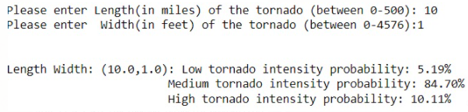
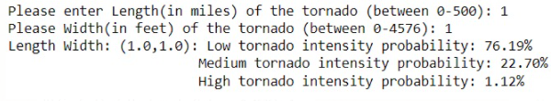
Tornadoes in the USA \\ Machine Learning \\ Logistic Regression Bonus
Bonus
Another ML model we built that was based on logistic regression was this: With two inputs from the user regarding width and length of a tornado, the model can provide results of probability of each severity category.

Slide 22

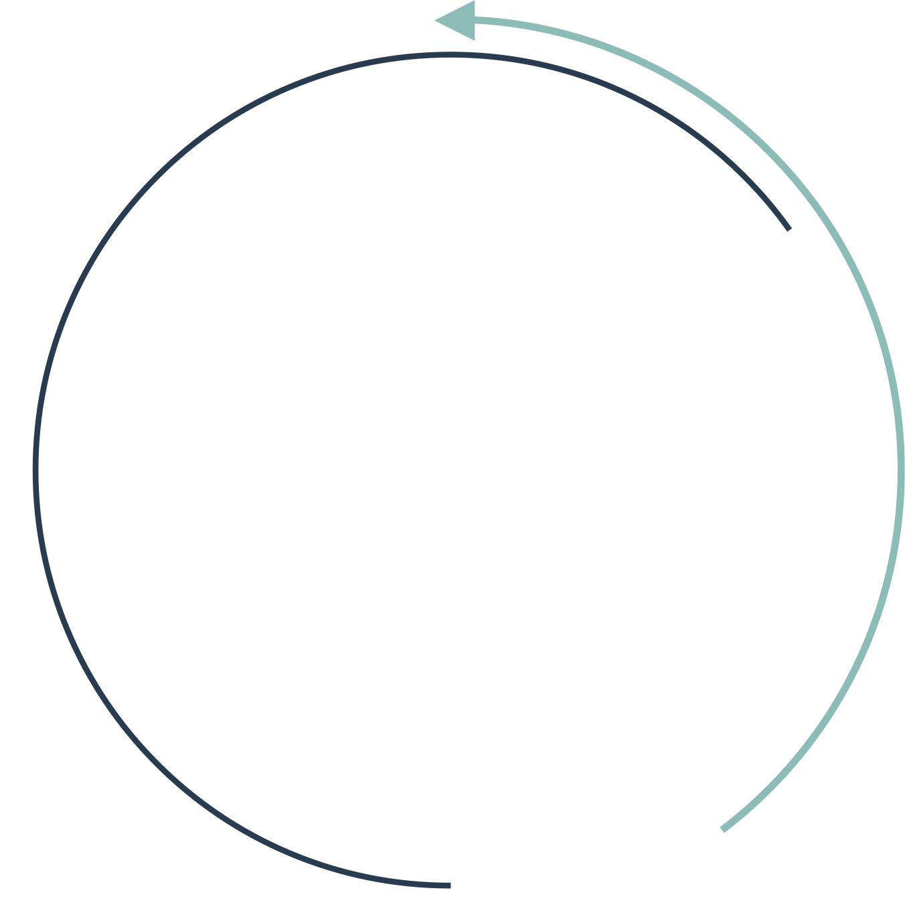

Tornadoes in the USA \\
Questions

